Slide 1
UPPER SIXTH ARTS
GEOGRAPHY
Lesson 16
Carrying Capacity
Notes:
Good morning, class, and welcome to our geography lesson. I am your geography teacher, Mr Kamdem. Today we are starting Lesson 16: Carrying Capacity.

Slide 2
CLASS INFO
Class, Chapter and Duration
Class | Upper Sixth Arts
Chapter | Module 4: Understanding and managing population dynamics across the world in general and Cameroon in particular
Duration | 2 periods (2 × 50 minutes)
Notes:
This lesson is for Upper Sixth Arts. It belongs to Module 4: Understanding and managing population dynamics across the world in general and Cameroon in particular. We shall need 2 periods to cover it.

Slide 3
IDENTIFICATION
Lesson Identification
Topic | Population Growth and Resources
Sub-topic | Population and Resource Relationships
Lesson | Lesson 16: Carrying Capacity
Notions / Concepts | Carrying capacity, S-curve (logistic growth), J-curve, overshoot, oscillation, instantaneous adjustment, overpopulation, sustainable and underpopulation regimes.
Syllabus focus | Meaning of carrying capacity; ways of adjusting to it (S-curve, J-curve, instantaneous adjustment); population-resource regimes (overpopulation, sustainable, underpopulation).
Competence | Learners are able to explain carrying capacity and the ways populations adjust to it, and apply them to overgrazing around Garoua.
Notes:
Our topic is Population Growth and Resources, and the sub-topic is Population and Resource Relationships. The key notions we shall use today are: carrying capacity, S-curve (logistic growth), J-curve, overshoot, oscillation, instantaneous adjustment, overpopulation, sustainable and underpopulation regimes. At the end, you should be able to do this: learners are able to explain carrying capacity and the ways populations adjust to it, and apply them to overgrazing around Garoua.

Slide 4

HOMEWORK CORRECTION
Correction of the Homework
Question (Lesson 15: Types of Migration):
Define carrying capacity.
Notes:
Before we start the new lesson, let us correct the homework I gave you at the end of Lesson 15: Types of Migration. The question was: Define carrying capacity. Take out your exercise books.

Slide 5
HOMEWORK CORRECTION
Correction: Possible Answer
Carrying capacity is the maximum number of people (or animals) an environment can support for a long time without being damaged.
Notes:
Here is a good answer. Carrying capacity is the maximum number of people (or animals) an environment can support for a long time without being damaged. Compare it with your own answer and correct your work in red.

Slide 6
LESSON PLAN
Lesson Plan
Correction of the homework
Objectives and recall
Real-life situation and action to take
Learning activities
Board summary
Evaluation, remediation and homework
Notes:
Here is the plan of our lesson today. First, we shall correct the homework. Then we shall look at the objectives and recall what you already know. After that, we shall study a situation from real life and the action to take, and do the learning activities. Finally, we shall copy the board summary, do the evaluation and the remediation, and I will give you the homework.

Slide 7
OBJECTIVES
Objectives
By the end of this lesson, you should be able to:
Define carrying capacity.
Describe the S-curve of progressive adjustment.
Notes:
Take your time to copy this part; we will continue together.

Slide 8
OBJECTIVES
Objectives (continued)
Describe the J-curve of overshoot and oscillation.
Describe instantaneous adjustment.
Describe the three population-resource regimes.
Notes:
By the end of this lesson, you should be able to do five things. Number 1: define carrying capacity. Number 2: describe the S-curve of progressive adjustment. Number 3: describe the J-curve of overshoot and oscillation. Number 4: describe instantaneous adjustment. Number 5: describe the three population-resource regimes.

Slide 9
PREVIOUS KNOWLEDGE
Previous Knowledge
Rural-rural migration moves herders to new pastures.
Overgrazing destroys grass.
Resources are limited.
Notes:
Let us first remember what you already know. Rural-rural migration moves herders to new pastures. Overgrazing destroys grass. Resources are limited. Keep this in mind, because we shall build on it today.

Slide 10
REAL-LIFE SITUATION
Situation in Real Life
A Fulani herdsman near Garoua has pasture for 50 cattle.
In the rainy season the grass is plentiful and his animals are fat, so he buys 50 more.
Soon the grass is eaten down to the bare soil, the ground becomes hard and dusty, and his 100 animals become thin and weak.
Notes:
Take your time to copy this part; we will continue together.

Slide 11
REAL-LIFE SITUATION
Situation in Real Life (continued)
His son asks: "Why did the herd suffer when it became bigger, and how many animals can the land really feed?"
Notes:
Listen carefully to this situation from real life. A Fulani herdsman near Garoua has pasture for 50 cattle. In the rainy season the grass is plentiful and his animals are fat, so he buys 50 more. Soon the grass is eaten down to the bare soil, the ground becomes hard and dusty, and his 100 animals become thin and weak. His son asks: "Why did the herd suffer when it became bigger, and how many animals can the land really feed?" Think about it, because I am going to ask you some questions.

Slide 12
REAL-LIFE SITUATION
Situation: Question 1
What is the problem in the situation?
Notes:
Question 1: What is the problem in the situation? Think for a moment, then raise your hand to answer.

Slide 13
REAL-LIFE SITUATION
Answer
The herdsman exceeded the number of animals the land can support.
Notes:
Good. The herdsman exceeded the number of animals the land can support.

Slide 14
REAL-LIFE SITUATION
Situation: Question 2
What is this limit called?
Notes:
Question 2: What is this limit called? Think for a moment, then raise your hand to answer.

Slide 15
REAL-LIFE SITUATION
Answer
The carrying capacity.
Notes:
Good. The carrying capacity.

Slide 16
REAL-LIFE SITUATION
Situation: Question 3
What happened to the land?
Notes:
Question 3: What happened to the land? Think for a moment, then raise your hand to answer.

Slide 17
REAL-LIFE SITUATION
Possible Answer
It was degraded: bare, hard and dusty soil.
Notes:
Good. It was degraded: bare, hard and dusty soil.

Slide 18
ACTION TO TAKE
Action to Take
Keep herds and farming within the carrying capacity of the land, and rotate pastures.
Notes:
From this situation, the action we are working towards in this lesson is the following: keep herds and farming within the carrying capacity of the land, and rotate pastures.

Slide 19
JUSTIFICATION
Justification of the Lesson
This lesson helps us to understand the limits of the environment and the need to balance population and resources.
Notes:
Why is this lesson important for you? This lesson helps us to understand the limits of the environment and the need to balance population and resources.

Slide 20
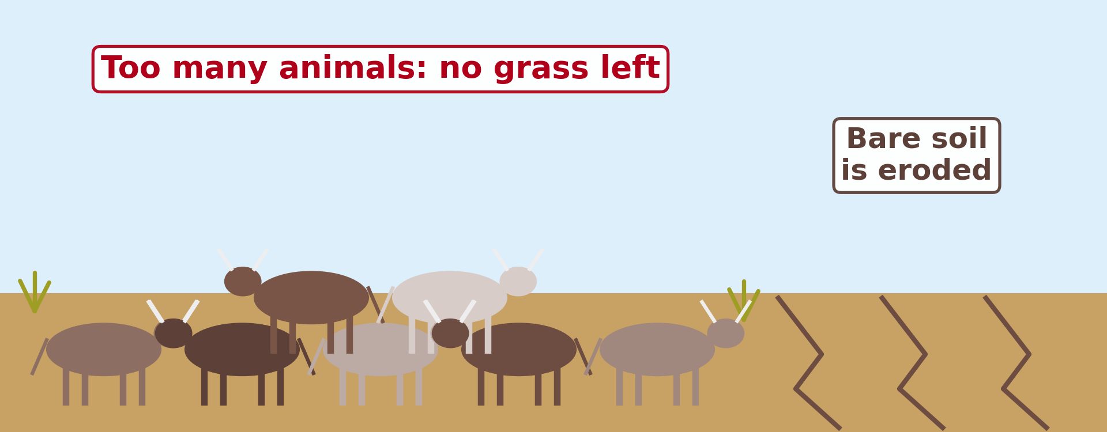
1. MEANING
Activity 1
Too many animals on a pasture.
Notes:
Activity 1. Look carefully at this diagram: too many animals on a pasture. Observe every detail before I ask the question.

Slide 21
1. MEANING
Activity 1: Question
What happens when the number of cattle exceeds the carrying capacity?
Notes:
Here is the question for Activity 1: What happens when the number of cattle exceeds the carrying capacity? Take one minute to think and write your answer in your rough notebook.

Slide 22
1. MEANING
Activity 1: Answer
The grass disappears, the soil is eroded and the animals become weak.
Notes:
Let us check the answer together. The grass disappears, the soil is eroded and the animals become weak.

Slide 23
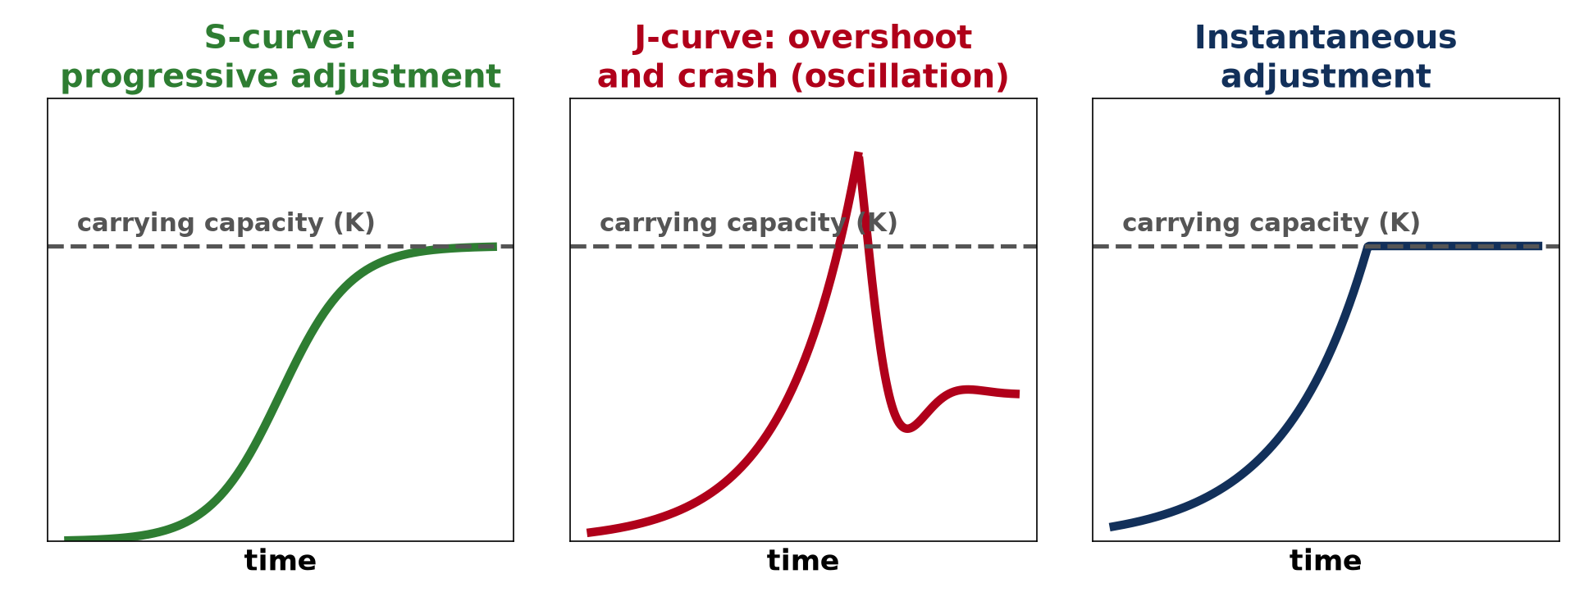
2. S-CURVE
Activity 2
Three ways of adjusting.
Notes:
Activity 2. Look carefully at this picture: three ways of adjusting. Observe every detail before I ask the question.

Slide 24
2. S-CURVE
Activity 2: Question
What happens to growth on an S-curve near the carrying capacity?
Notes:
Here is the question for Activity 2: What happens to growth on an S-curve near the carrying capacity? Take one minute to think and write your answer in your rough notebook.

Slide 25
2. S-CURVE
Activity 2: Answer
It slows down and the population becomes stable.
Notes:
Let us check the answer together. It slows down and the population becomes stable.

Slide 26
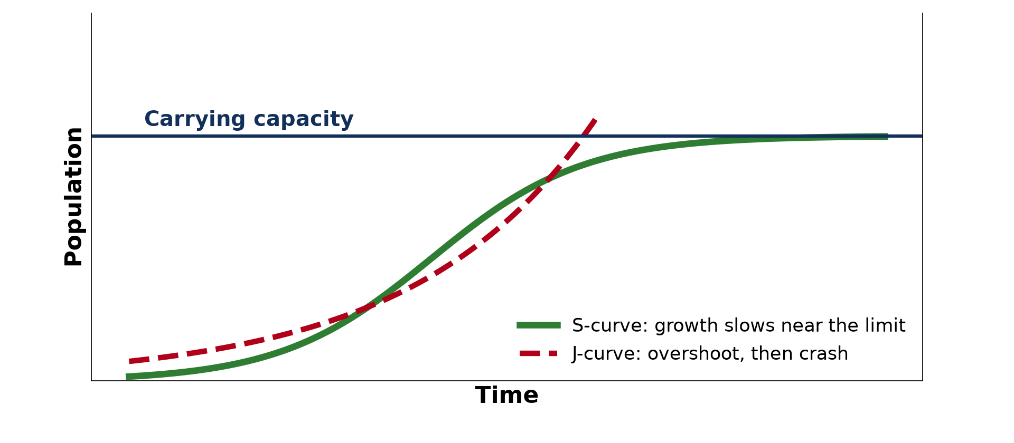
2. J-CURVE
Activity 3
The S-curve and the J-curve.
Notes:
Activity 3. Look carefully at this diagram: the S-curve and the J-curve. Observe every detail before I ask the question.

Slide 27
2. J-CURVE
Activity 3: Question
What happens after the J-curve overshoots the carrying capacity?
Notes:
Here is the question for Activity 3: What happens after the J-curve overshoots the carrying capacity? Take one minute to think and write your answer in your rough notebook.

Slide 28
2. J-CURVE
Activity 3: Answer
The population crashes, then may oscillate.
Notes:
Let us check the answer together. The population crashes, then may oscillate.

Slide 29
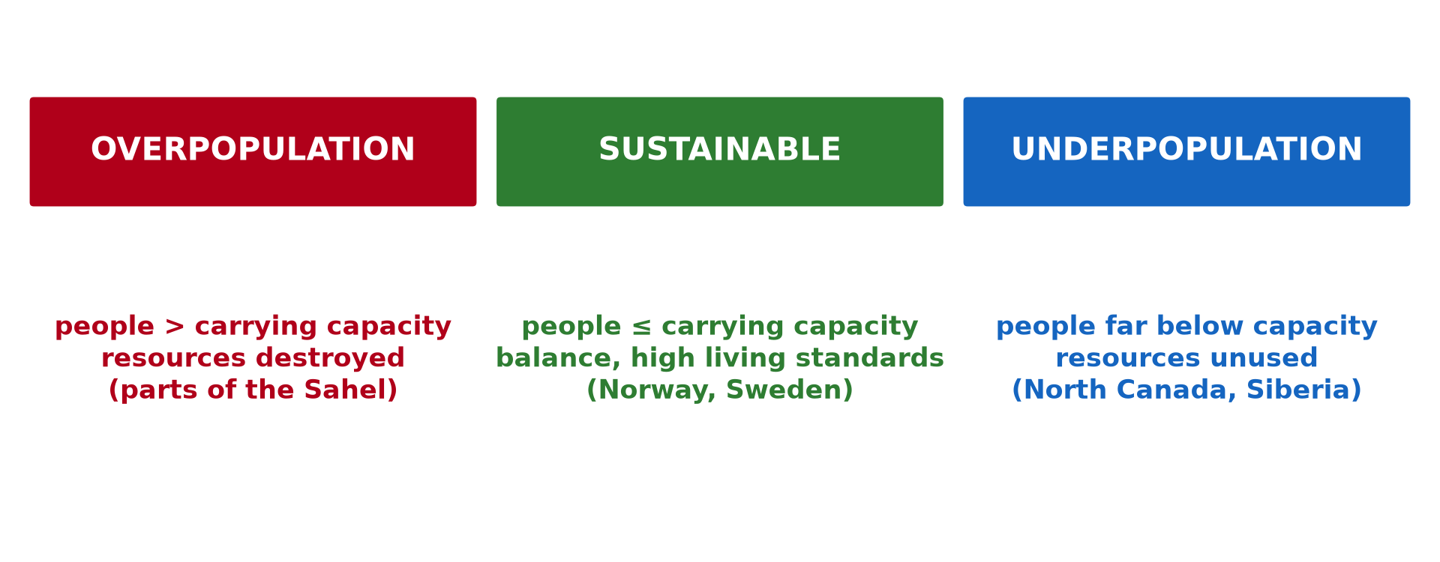
3. REGIMES
Activity 4
Three population-resource regimes.
Notes:
Activity 4. Look carefully at this picture: three population-resource regimes. Observe every detail before I ask the question.

Slide 30
3. REGIMES
Activity 4: Question
In which regime are resources not fully used?
Notes:
Here is the question for Activity 4: In which regime are resources not fully used? Take one minute to think and write your answer in your rough notebook.

Slide 31
3. REGIMES
Activity 4: Answer
Underpopulation.
Notes:
Let us check the answer together. Underpopulation.

Slide 32

3. REGIMES
Activity 5
Drought in the Sahel.
Notes:
Activity 5. Look carefully at this picture: drought in the Sahel. Observe every detail before I ask the question.

Slide 33
3. REGIMES
Activity 5: Question
Why are parts of the Sahel said to be overpopulated?
Notes:
Here is the question for Activity 5: Why are parts of the Sahel said to be overpopulated? Take one minute to think and write your answer in your rough notebook.

Slide 34
3. REGIMES
Activity 5: Answer
Too many people and animals for the land lead to desertification and food shortages.
Notes:
Let us check the answer together. Too many people and animals for the land lead to desertification and food shortages.

Slide 35
BOARD SUMMARY
Board Summary
Topic: Population Growth and Resources
Sub-topic: Population and Resource Relationships
Lesson 16: Carrying Capacity
Notes:
Now we are going to copy the board summary. Write the title and the headings neatly in your notebooks. I will give you enough time for each slide, so do not rush.

Slide 36
BOARD SUMMARY
DEFINITIONS
The key terms of this lesson are defined as follows:
Carrying capacity (K): It is the maximum number of individuals that an environment can support for a long time without being damaged.
Notes:
Let us copy the definitions. The key terms of this lesson are defined as follows. On this slide we have Carrying capacity (K). Write each point on a new line, with the key term first, and explain it in your own words when we revise. When you finish, we go to the next slide.

Slide 37
BOARD SUMMARY
DEFINITIONS (continued)
Overshoot: It is the situation where a population grows beyond the carrying capacity.
Oscillation: It is the repeated rise and fall of a population around the carrying capacity.
Notes:
We continue with the definitions. On this slide we have Overshoot and Oscillation. Write each point on a new line, with the key term first, and explain it in your own words when we revise. When you finish, we go to the next slide.

Slide 38
BOARD SUMMARY
DEFINITIONS (continued)
Population-resource regime: It is the type of relationship between the size of a population and its resources.
Notes:
We continue with the definitions. On this slide we have Population-resource regime. Write each point on a new line, with the key term first, and explain it in your own words when we revise.

Slide 39
BOARD SUMMARY
1. Meaning of Carrying Capacity
Carrying capacity is explained as follows:
A limit: Carrying capacity is the largest population that an area can feed and support without being damaged. It depends on the food, water and space available.
Illustration: overgrazing
Notes:
Let us copy Meaning of Carrying Capacity. Carrying capacity is explained as follows. Copy the point on A limit on the left, then draw the diagram on the right: overgrazing. Give it a title and label it clearly.

Slide 40
BOARD SUMMARY
1. Meaning of Carrying Capacity
Example: A pasture near Garoua that can feed 50 cattle is destroyed if 100 graze on it. The grass disappears and the soil is eroded.
Notes:
We continue with Meaning of Carrying Capacity. Copy the point on Example: write the key term first, then its explanation.

Slide 41
BOARD SUMMARY
1. Meaning of Carrying Capacity
Human populations: For people, carrying capacity is not fixed. Technology, such as irrigation and fertilisers, and trade can raise it.
Notes:
We continue with Meaning of Carrying Capacity. Copy the point on Human populations: write the key term first, then its explanation.

Slide 42
BOARD SUMMARY
2. Ways of Adjusting to Carrying Capacity
Populations adjust to carrying capacity in the following ways:
Progressive adjustment (S-curve): Growth is slow at first, then fast, then slows down near the carrying capacity and stabilises. Fish introduced into a large lake grow in this way.
Illustration: growth curves
Notes:
Let us copy Ways of Adjusting to Carrying Capacity. Populations adjust to carrying capacity in the following ways. Copy the point on Progressive adjustment (S-curve) on the left, then draw the diagram on the right: growth curves. Give it a title and label it clearly.

Slide 43
BOARD SUMMARY
2. Ways of Adjusting to Carrying Capacity
Overshoot and oscillation (J-curve): Growth is exponential and passes the carrying capacity, then the population crashes through starvation or disease. Insects and algae behave in this way after a favourable season.
Illustration: carrying capacity
Notes:
Copy the point on Overshoot and oscillation (J-curve) on the left, then draw the diagram on the right: carrying capacity. Give it a title and label it clearly.

Slide 44
BOARD SUMMARY
2. Ways of Adjusting to Carrying Capacity
Boom and bust: After a crash, the population may recover and grow again. It then repeats the cycle of rises and falls around the carrying capacity.
Notes:
We continue with Ways of Adjusting to Carrying Capacity. Copy the point on Boom and bust: write the key term first, then its explanation.

Slide 45
BOARD SUMMARY
2. Ways of Adjusting to Carrying Capacity
Instantaneous adjustment: The population stops abruptly at the carrying capacity without passing it. This is rare, for example when a volcanic eruption suddenly destroys the food of island birds.
Notes:
We continue with Ways of Adjusting to Carrying Capacity. Copy the point on Instantaneous adjustment: write the key term first, then its explanation.

Slide 46
BOARD SUMMARY
3. Population-Resource Regimes
The relationship between population and resources gives the following regimes:
Overpopulation regime: The population exceeds the carrying capacity, causing deforestation, overgrazing, water shortages and poverty. Parts of the Sahel are in this situation.
Illustration: population-resource regimes
Notes:
Let us copy Population-Resource Regimes. The relationship between population and resources gives the following regimes. Copy the point on Overpopulation regime on the left, then draw the diagram on the right: population-resource regimes. Give it a title and label it clearly.

Slide 47
BOARD SUMMARY
3. Population-Resource Regimes
Sustainable (optimum) regime: The population is at or below the carrying capacity, and resources are managed carefully. Norway and Sweden are examples.
Notes:
We continue with Population-Resource Regimes. Copy the point on Sustainable (optimum) regime: write the key term first, then its explanation.

Slide 48
BOARD SUMMARY
3. Population-Resource Regimes
Underpopulation regime: The population is far below the carrying capacity, with rich resources, labour shortages and small markets. Northern Canada and Siberia are examples.
Notes:
We continue with Population-Resource Regimes. Copy the point on Underpopulation regime: write the key term first, then its explanation.

Slide 49
FORMATIVE EVALUATION
Evaluation 1
Distinguish between the S-curve and the J-curve.
Notes:
Now let us check what you have understood. Question 1: Distinguish between the S-curve and the J-curve. Answer in your exercise book.

Slide 50
FORMATIVE EVALUATION
Expected Answer
On the S-curve growth slows and stabilises at the carrying capacity; on the J-curve growth overshoots it and then crashes.
Notes:
The expected answer is: on the S-curve growth slows and stabilises at the carrying capacity; on the J-curve growth overshoots it and then crashes. If you got it right, well done.

Slide 51
FORMATIVE EVALUATION
Evaluation 2
Which curve is more stable, and why?
Notes:
Now let us check what you have understood. Question 2: Which curve is more stable, and why? Answer in your exercise book.

Slide 52
FORMATIVE EVALUATION
Expected Answer
The S-curve, because the population adjusts to its resources without destroying them.
Notes:
The expected answer is: the S-curve, because the population adjusts to its resources without destroying them. If you got it right, well done.

Slide 53
REMEDIATION
Remediation
Fill in the blanks:
The maximum population an environment can support is its ______ capacity.
Logistic growth has the shape of the letter ______.
Norway is an example of a ______ regime.
Notes:
For those who need more practice, fill in the blanks in your exercise book. The answers are: number 1, carrying; number 2, S; number 3, sustainable.

Slide 54
HOMEWORK
Homework
Give one indicator of overpopulation.
Notes:
For your homework: Give one indicator of overpopulation. We shall correct it at the beginning of our next lesson.

Slide 55
NEXT LESSON
Next Lesson
Our next lesson will be on:
Lesson 17: Overpopulation, Underpopulation and Optimum Population
Notes:
Our next lesson will be on Lesson 17: Overpopulation, Underpopulation and Optimum Population. Thank you for your attention, and see you next time.

Slide 56
BILINGUAL GAME
Bilingual Game (Jeu Bilingue)
English | Français
Carrying capacity | La capacité de charge
Overpopulation | La surpopulation
Sustainable | Durable
Resources | Les ressources
Underpopulation | La sous-population
Overgrazing | Le surpâturage
Notes:
Let us play the bilingual game. I say a word in English, and you give me the French word. Then we do the reverse.

Slide 57
LOGBOOK
Official Logbook (1/2)
Module / Topic | Population Growth and Resources
Lesson Title | Lesson 16: Carrying Capacity
Expected Learning Outcomes | Define carrying capacity. Describe the S-curve of progressive adjustment. Describe the J-curve of overshoot and oscillation. Describe instantaneous adjustment. Describe the three population-resource regimes.
Competence | Learners are able to explain carrying capacity and the ways populations adjust to it, and apply them to overgrazing around Garoua.
Notes:
I record this information in the official logbook of the class after the lesson.

Slide 58
LOGBOOK
Official Logbook (2/2)
Matter Taught | DEFINITIONS; Meaning of Carrying Capacity; Ways of Adjusting to Carrying Capacity; Population-Resource Regimes.
Evaluation | Formative evaluation and remediation exercise.
Homework | Give one indicator of overpopulation.
Enrolment / Present / Absent | ____ / ____ / ____
Achievement | To be completed after the lesson.
Notes:
I complete the second page of the logbook: the matter taught, the evaluation, the homework and the attendance.

Slide 59
TEACHER'S NOTE
Teacher's Note
Timing: Homework correction, plan, objectives 8 min | Recall, situation, action 10 min | 5 activities 30 min | Board summary (copying) 30 min | Evaluation, remediation 10 min | Homework, next lesson 5 min | Logbook 7 min
Without the projector (Activity 1): describe an overgrazed pasture.
Without the projector (Activity 2): draw the S-curve.
Without the projector (Activity 3): draw the J-curve and the crash.
Without the projector (Activity 4): write the three regimes.
Without the projector (Activity 5): describe the Sahel.
Notes:
This slide is for me, the teacher: it gives the timing of the lesson and what to do if the projector is not available.

Slide 60
REFERENCES
References
Geography Syllabus for Sixth Forms (Lower and Upper Sixth), MINESEC, 2019 — Module 4 (Population Geography).
Teacher's course notes: Mr KAMDEM E., Population Geography (USA), GBHS Garoua, 2026.
United Nations, World Population Prospects 2024.
Photo, Activity 5: “Imagine a world without trees” by aloshbennett, CC BY 2.0, via Flickr (https://www.flickr.com/photos/13203757@N00/3480223314)
Diagrams and animations: drawn for this lesson (Geography Department).
Notes:
These are the references and picture credits used to prepare this lesson.

